Slide 1
Deep Learning Models for Time-series Traffic Volume Data
Impact of temperature, weather, time information on the traffic volume
Big Data Analytics
Jieun Lee (222DBG04)
Doyeon Lee (222DBG02)

Slide 2
Table of contents
1
2
3
4
5
6
Project Introduction
Dataset
Proposed Approach
Evaluation Metrics
Overall Performances
Conclusion
Notes:
This are the table of contents of our presentation.

Slide 3
Project Introduction
Analyze the impact of temperature, weather, date and time information data on the traffic volume.
Develop the traffic volume prediction model based on the given weather conditions.
Pursue and evaluative comparison of deep learning model to enhance model efficacy and performance metrics.
Based on prior research, we employed LSTM, GRU, and CNN-LSTM models and proceed to compare their performance.
3
Notes:
As we described on our first presentation, our project goal is to analyze the impact of temperature, weather, date, and time information data on the traffic volume. Based on our prior research, we employed LSTM, GRU and CNN-LSTM models.

Slide 4
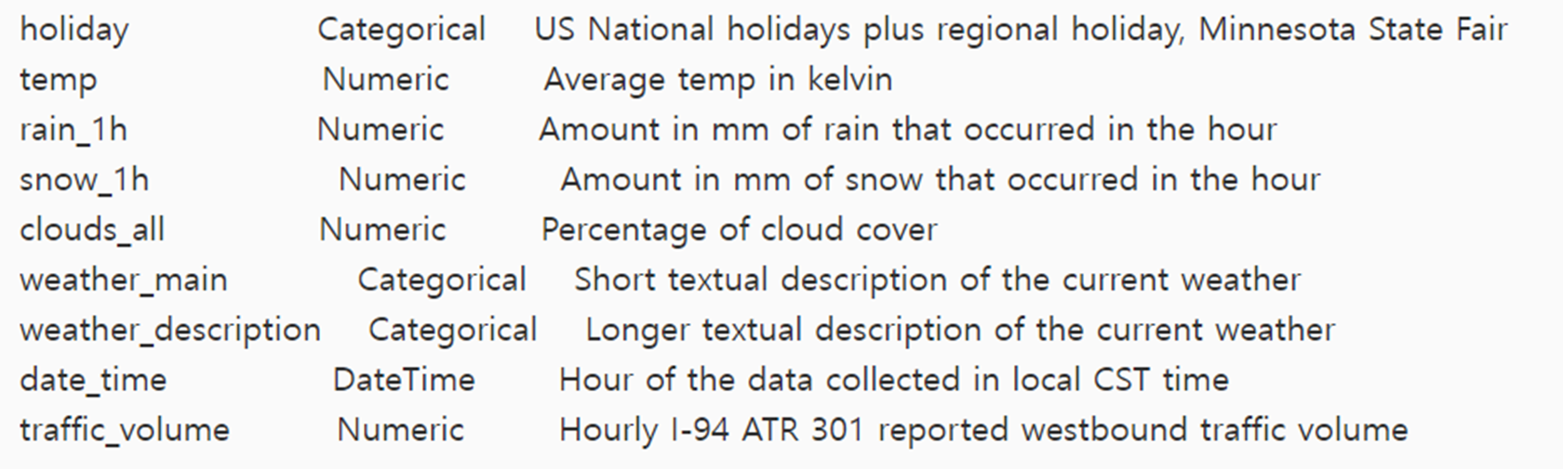
Dataset
Description: Minneapolis-St Paul, MN traffic volume data for westbound I-94
Data collected period: 2014 - 2018
Num of Instance: 48,204
Variables:
4
Notes:
We used traffic volume data provided from the Minnesota Department of Transportation and the weather data provided from Open Weather Map. There are about 48 thousands instances of data.

Slide 5
Data Preprocess
1
Change Variable’s types
holiday : Categorial → 0 or 1
weather_main : Categorical → Label Encoding
Temperature : Convert Kelvin to Celsius
Date_time : change to datetime (%Y-%m-%d %H)
Drop Outlier
2
Rain_1h : Drop outliers (by setting x < 2,000)
3
Others
Weather_description: Delete the variable
Employed a linear interpolation
Utilized sliding window (to 24-hr intervals)
5
Notes:
Through our data preprocess, we changed variable types such as using label encoding and converting the measure. We also drop the outlier of rain variable and employed linear interpolation for missing time data and sliding window to 24 hours intervals. After the preprocess, we got about 52 thousand data for the modeling.

Slide 6
Proposed Approach
LSTM
Created to manage long-term data dependencies.
Shown effectiveness in utilizing unique memory cells to recognize long dependencies.
GRU
Handle long-term dependencies and efficient with sequential data.
CNN-LSTM
Enhances the predictive accuracy by effectively capturing complex spatial-temporal interactions
6
Notes:
We will use 3 deep learning models.
LSTM and GRU models exhibit excellent capabilities in handling long-term dependencies. They are well-suited for predicting over extended sequences and can effectively learn complex patterns, such as traffic flow. Additionally, the cnn-lstm model was used because it can learn temporal and spatial patterns simultaneously.

Slide 7
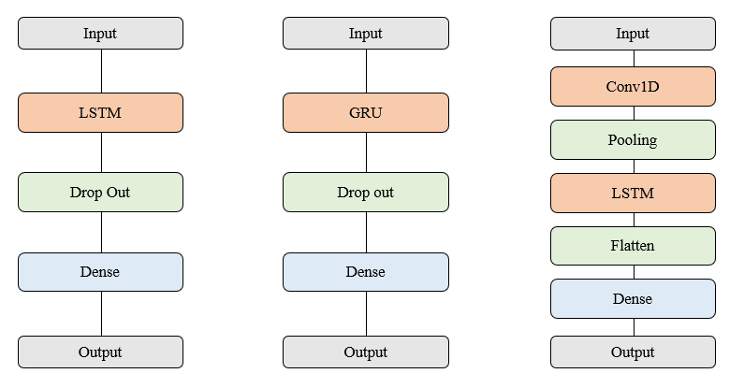
Proposed Approach
< LSTM >
< GRU >
< CNN-LSTM >
7
Notes:
This is our deep learning model structures.

Slide 8



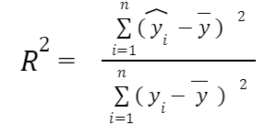
Evaluation Metrics
To effectively examine the regression issue addressed in this paper, metrics such as MAE, MSE, MAPE and R-squared were utilized.
Mean Average Absolute Error (MAE) :
Mean Square Error(MSE) :
Mean Absolute Percentage Error(MAPE) :
R-squared :
8
Notes:
To effectively examine the regression issue addressed in this paper, metrics such as MAE, MSE, MAPE and R-squared were utilized.

Slide 9
Overall Performance
To understand the impact of additional variables such as weather, holidays, and precipitation on prediction performance, we conducted modeling in two phases:
(1) Using solely traffic volume data
(2) Incorporating the additional variables (weather, holidays, precipitation)
The predictive results of the LSTM, GRU, and CNN-LSTM models all showed a high explanatory power of 99%.
The CNN-LSTM model exhibiting the highest performance among them.
9
Notes:
we conducted modeling part in two phases:
It is Using solely traffic volume data for training and second one is Incorporating the additional variables (weather, holidays, precipitation)
The predict results of the these models all showed a high explanatory power over 99%.
The CNN-LSTM model shows the highest performance among them.

Slide 10
Overall Performance
Prediction accuracy of train models including only traffic volume variables.
Models | R2 | MSE | MAE | MAPE
GRU | 0.9960 | 0.1488 | 0.3426 | 0.1397
LSTM | 0.9984 | 0.0578 | 0.2132 | 0.0549
CNN + LSTM | 0.9999 | 0.0014 | 0.0347 | 0.0248
CNN + LSTM shows the highest performance among the three models.
10
Notes:
When we use only traffic volume data for training, CNN-LSTM model shows the highest performance and minimum errors.

Slide 11
Overall Performance
Prediction accuracy of train models including the additional variables.
Models | R2 | MSE | MAE | MAPE
GRU | 0.9986 | 0.0529 | 0.2023 | 0.0874
LSTM | 0.9993 | 0.0232 | 0.1273 | 0.0402
CNN + LSTM | 0.9999 | 0.0014 | 0.0312 | 0.0209
CNN + LSTM shows the highest performance among the three models.
11
Notes:
Also, we used not only traffic volume data, but also the additional variables.
You can see that performance increases and errors decrease when adding additional variables compared to using only traffic volume to training.

Slide 12
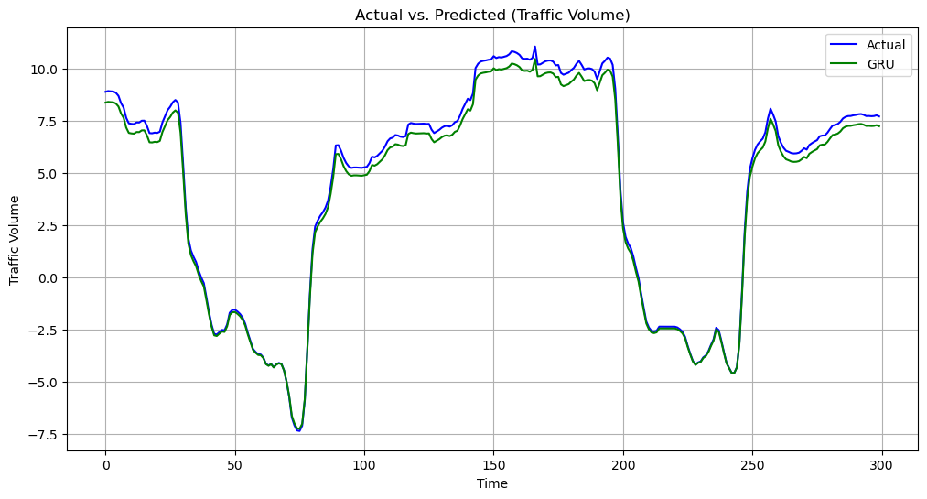
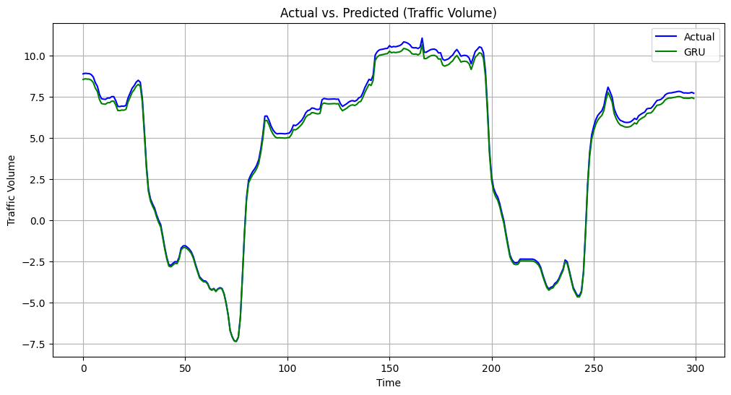
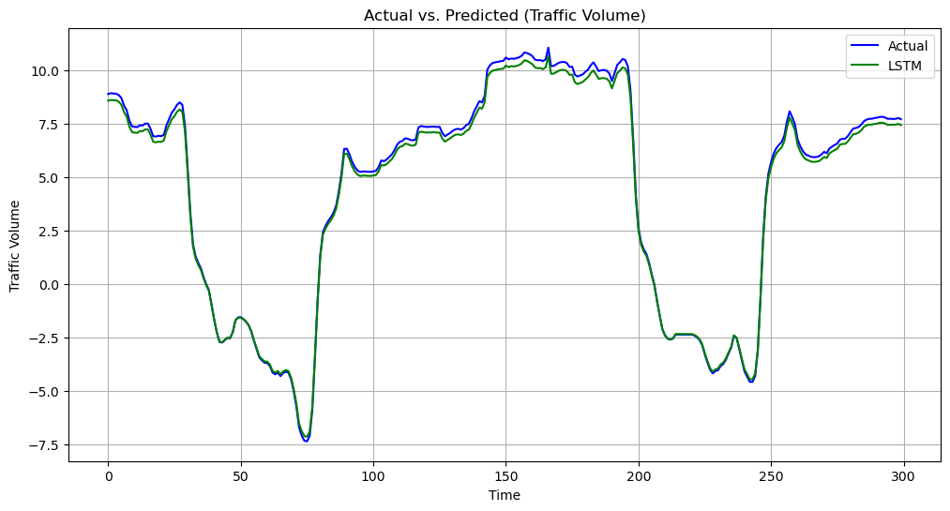
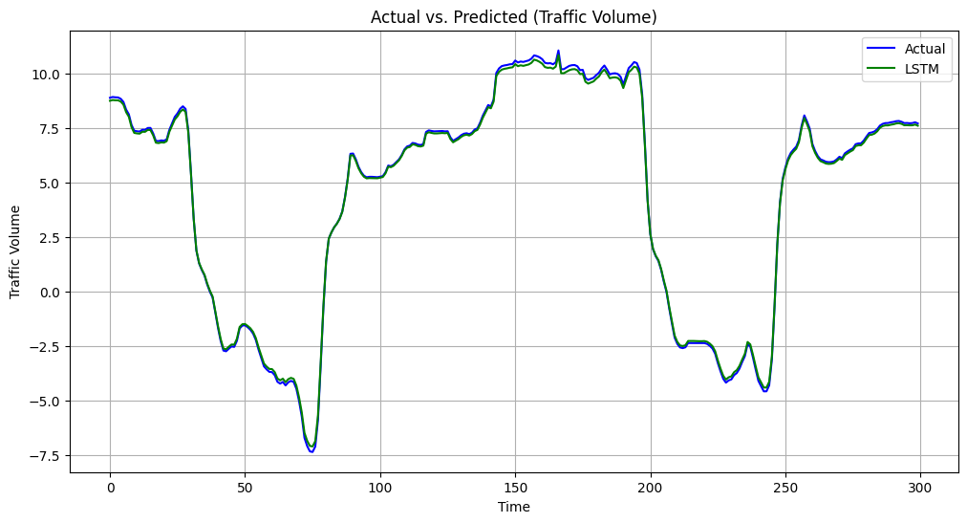
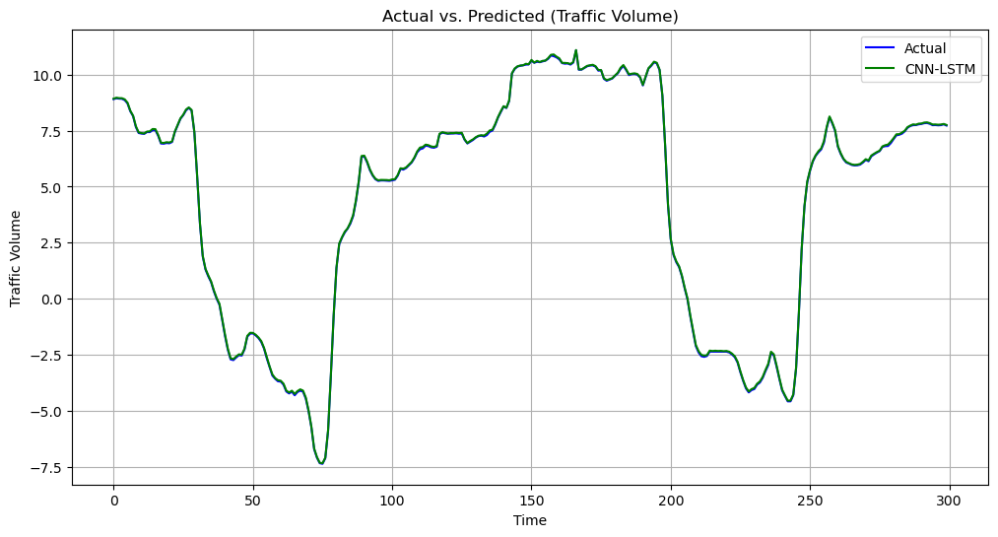
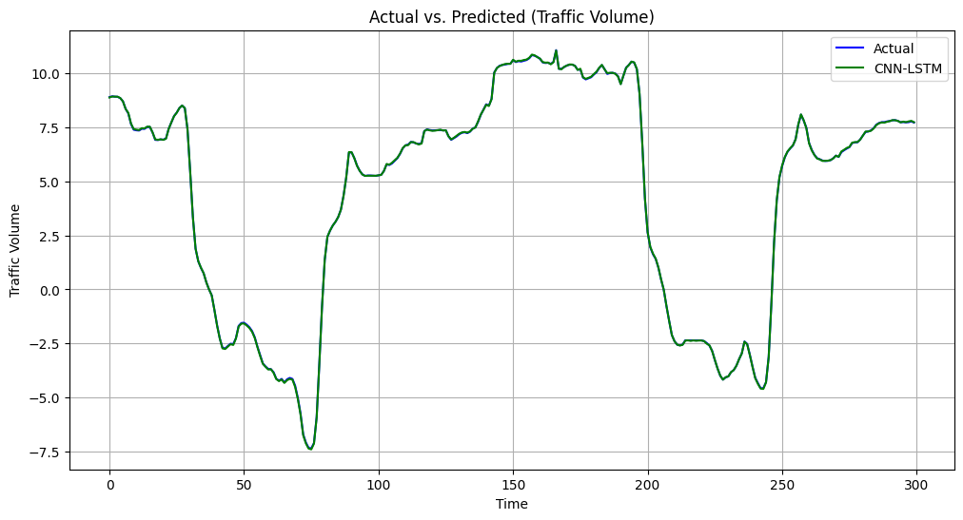
Only traffic variable -
Including other variables -
GRU
LSTM
CNN-
LSTM
12
Notes:
In this graph, you can see the prediction is more accurate when we use additional variables for training.

Slide 13
Conclusion
The model error reduced when including additional variables such as weather conditions, holidays, and rainfall compared to predicting traffic solely based on the traffic volume variable.
The predictive results of all three models exhibit an explanatory power of over 99%, with CNN-LSTM showing the smallest errors among them.
In this study, data collected from highways was utilized. Therefore, in future research, we aim to predict traffic volume not only on highways but also on general roads to explore the differences in the distribution of traffic volume between highways and general roads.
15
Notes:
Through our analysis, we were able to obtain the following results: The model error decreased when additional variables such as weather conditions, holidays, and rainfall were included.Also, the CNN-LSTM model exhibited the highest performance and the lowest error. In this study, we utilized highway traffic data. However, in future research, our objective will be to predict traffic volume not only on highways but also on general roads.

Slide 14
Reference
Hogue, John. (2019). Metro Interstate Traffic Volume. UCI Machine Learning Repository. https://doi.org/10.24432/C5X60B.
Minnesota Department of Transportation. Minnesota Department of Transportation - MnDOT. (n.d.). https://www.dot.state.mn.us/
Сurrent weather and forecast - openweathermap. (n.d.). https://openweathermap.org/
P. Poonia and V. K. Jain, "Short-Term Traffic Flow Prediction: Using LSTM," 2020 International Conference on Emerging Trends in Communication, Control and Computing (ICONC3), Lakshmangarh, India, 2020, pp. 1-4, doi: 10.1109/ICONC345789.2020.9117329.
Ke Wang, Changxi Ma, Yihuan Qiao, Xijin Lu, Weining Hao, Sheng Dong, <A hybrid deep learning model with 1DCNN-LSTM-Attention networks for short-term traffic flow prediction, Volume 583, 2021,126293, ISSN 0378-4371,https://doi.org/10.1016/j.physa.2021.126293.
Y. Tao, P. Sun and A. Boukerche, "A Delay-Based Deep Learning Approach for Urban Traffic Volume Prediction," ICC 2020 - 2020 IEEE International Conference on Communications (ICC), Dublin, Ireland, 2020, pp. 1-6, doi: 10.1109/ICC40277.2020.9149018.
16

Slide 15
Thank you!
Do you have any questions?
Jieun Lee
222dbg04@ewhain.net
Doyeon Lee
dyan.lee@ewhain.net
Notes:
This is end of our presentation. Thank you for listening.

